Slide 1

CHAPTER 8
PROPERTIES OF RELATIONS
Copyright © Cengage Learning. All rights reserved.

Slide 2

8.4
Modular Arithmetic with Applications
to Cryptography
Copyright © Cengage Learning. All rights reserved.

Slide 3
Modular Arithmetic with Applications to Cryptography
Cryptography is the study of methods for sending secret messages. It involves encryption, in which a message, called plaintext, is converted into a form, called ciphertext, that is sent over a channel possibly open to view by outside parties.
The receiver of the ciphertext uses decryption to convert the ciphertext back into plaintext.

Slide 4
Modular Arithmetic with Applications to Cryptography
Many systems for sending secret messages require both the sender and the receiver to know both the encryption and the decryption procedures.
For instance, an encryption system once used by Julius Caesar, and now called the Caesar cipher, encrypts messages by changing each letter of the alphabet to the one three places farther along, with X wrapping around to A, Y to B, and Z to C.

Slide 5
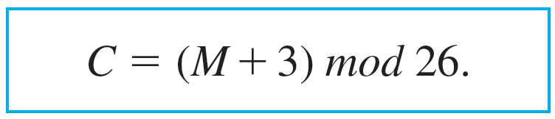
Modular Arithmetic with Applications to Cryptography
In other words, say each letter of the alphabet is coded by its position relative to the others—so that
A = 01, B = 02, … , Z = 26.
If the numerical version of the plaintext for a letter is denoted M and the numeric version of the ciphertext is denoted C, then

Slide 6
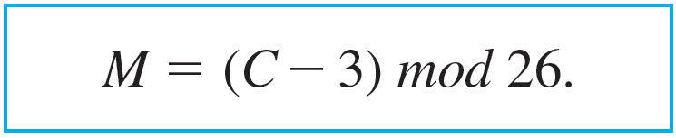
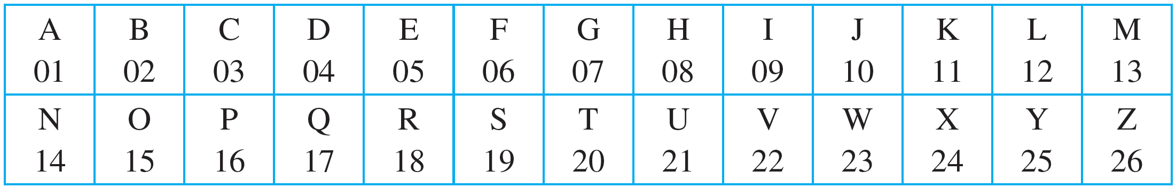
Modular Arithmetic with Applications to Cryptography
The receiver of such a message can easily decrypt it by using the formula
For reference, here are the letters of the alphabet, together with their numeric equivalents:

Slide 7
Example 8.4.1 – Encrypting and Decrypting with the Caesar Cipher
a. Use the Caesar cipher to encrypt the message HOW ARE YOU.
b. Use the Caesar cipher to decrypt the message L DP ILQH.

Slide 8
Example 8.4.1 – Solution
a. First, translate the letters of HOW ARE YOU into their numeric equivalents:
08 15 23 01 18 05 25 15 21.
Next, encrypt the message by adding 3 to each number. The result is
11 18 26 04 21 08 02 18 24.
Finally, substitute the letters that correspond to these numbers. The encrypted message becomes
KRZ DUH BRX.

Slide 9
Example 8.4.1 – Solution
continued
b. First, translate the letters of L DP ILQH into their numeric equivalents:
12 04 16 09 12 17 08.
Next, decrypt the message by subtracting 3 from each number:
09 01 13 06 09 14 05.
Then, translate back into letters to obtain the original message: I AM FINE.

Slide 10
Properties of Congruence Modulo n

Slide 11
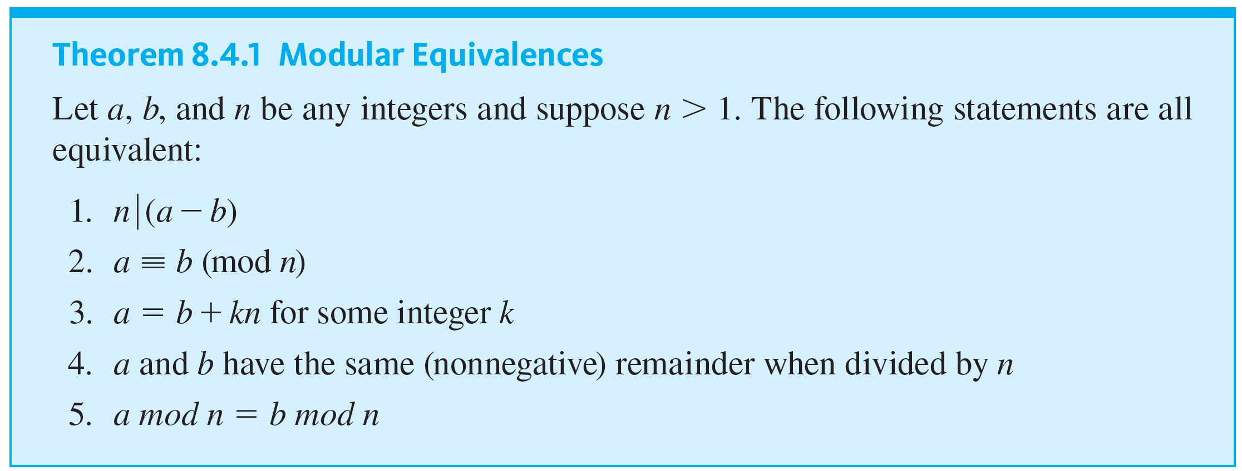
Properties of Congruence Modulo n

Slide 12
Properties of Congruence Modulo n
Another consequence of the quotient-remainder theorem is this: When an integer a is divided by a positive integer n, a unique quotient q and remainder r are obtained with the property that a = nq + r and 0 ≤ r < n.
Because there are exactly n integers that satisfy the inequality 0 ≤ r < n (the numbers from 0 through n − 1), there are exactly n possible remainders that can occur.

Slide 13
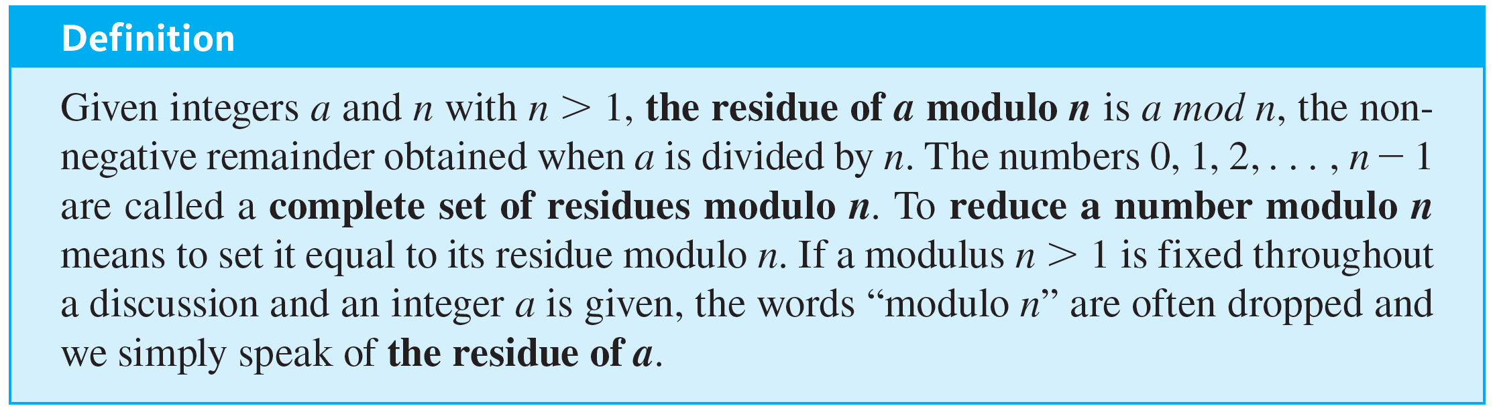
Properties of Congruence Modulo n
These are called the least nonnegative residues modulo n or simply the residues modulo n.

Slide 14
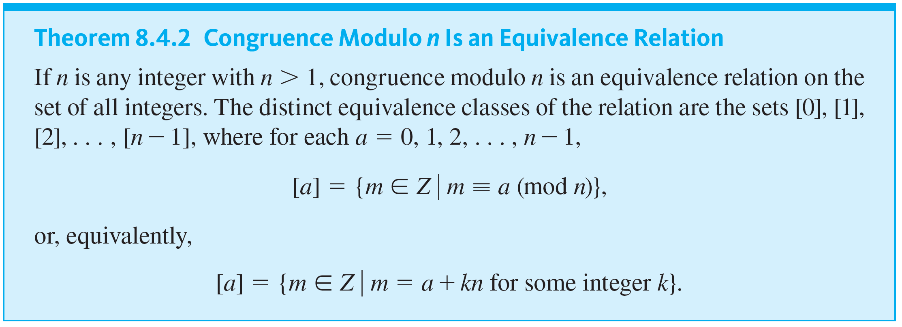
Properties of Congruence Modulo n

Slide 15
Modular Arithmetic

Slide 16
Modular Arithmetic
A fundamental fact about congruence modulo n is that if you first perform an addition, subtraction, or multiplication on integers and then reduce the result modulo n, you will obtain the same answer as if you had first reduced each of the numbers modulo n, performed the operation, and then reduced the result modulo n. For instance, instead of computing
(5 · 8) = 40 ≡ 1 (mod 3)
you will obtain the same answer if you compute
(5 mod 3) (8 mod 3) = 2 · 2 = 4 ≡ 1 (mod 3).

Slide 17
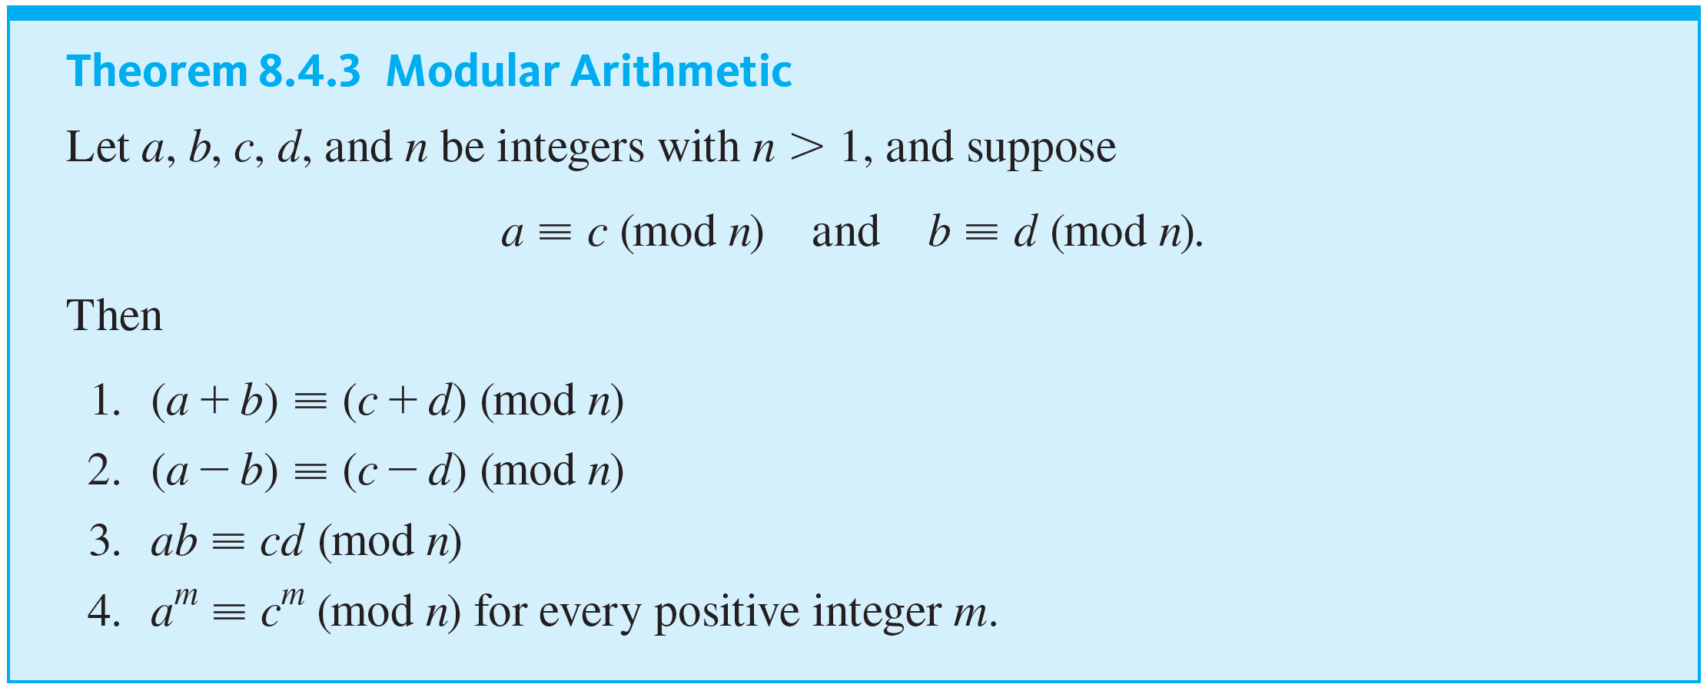
Modular Arithmetic

Slide 18

Example 8.4.2 – Getting Started with Modular Arithmetic
The most practical use of modular arithmetic is to reduce computations involving large integers to computations involving smaller ones. For instance, note that 55 ≡ 3 (mod 4) because 55 − 3 = 52, which is divisible by 4, and 26 ≡ 2 (mod 4) because 26 − 2 = 24, which is also divisible by 4. Verify the following statements.
a. 55 + 26 ≡ (3 + 2) (mod 4) b. 55 − 26 ≡ (3 − 2) (mod 4)
c. 55 · 26 ≡ (3 · 2) (mod 4) d.

Slide 19




Example 8.4.2 – Solution
a. Compute 55 + 26 = 81 and 3 + 2 = 5. By definition of congruence modulo n, to show that 81 ≡ 5 (mod 4), you need to show that
But this is true because
81 − 5 = 76, and
since 76 = 4 · 19.
b. Compute 55 − 26 = 29 and 3 − 2 = 1. By definition of congruence modulo n, to show that 29 ≡ 1 (mod 4), you need to show that
But this is true because 29 − 1 = 28, and
since 28 = 4 · 7.

Slide 20





Example 8.4.2 – Solution
continued
c. Compute 55 · 26 = 1430 and 3 · 2 = 6. By definition of congruence modulo n, to show that 1430 ≡ 6 (mod 4), you need to show that
But this is true because 1430 − 6 = 1424, and
since 1424 = 4 · 356.
By definition of congruence modulo n, to show that 3025 ≡ 9 (mod 4), you need to show that
d. Compute
But this is true because 3025 − 9 = 3016, and
since 3016 = 4 · 754.

Slide 21
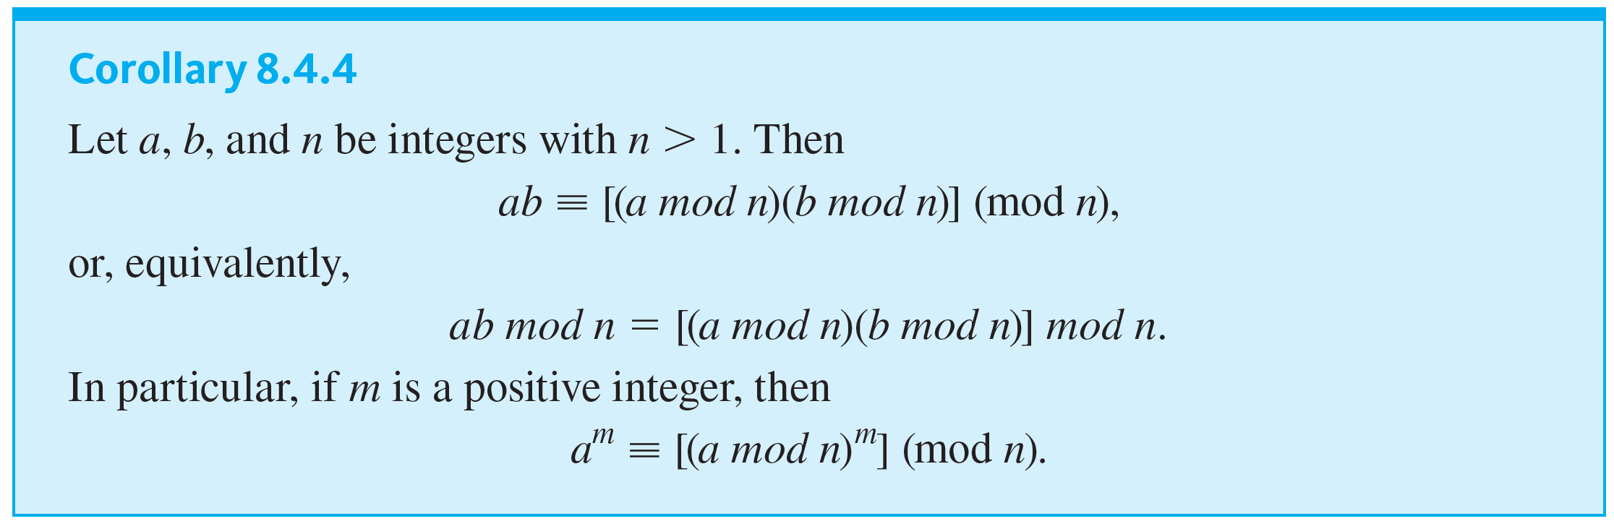
Modular Arithmetic

Slide 22
Example 8.4.3 – Computing a Product Modulo n
Note that 55 ≡ 3 (mod 4) and 26 ≡ 2 (mod 4). Because both 3 and 2 are less than 4, each of these numbers is a least nonnegative residue modulo 4. Therefore, 55 mod 4 = 3 and 26 mod 4 = 2. Use the notation of Corollary 8.4.4 to find the residue of 55 · 26 modulo 4.

Slide 23
Example 8.4.3 – Solution
We know that to use a calculator to compute remainders, you can use the formula n mod d = n − d · ⌊n ∕ d⌋. If you are using a hand calculator with an “integer part” feature and both n and d are positive, then ⌊n ∕ d⌋ is the integer part of the division of n by d.
When you divide a positive integer n by a positive integer d with a more basic calculator, you can see ⌊n ∕ d⌋ on the calculator display by simply ignoring the digits that follow the decimal point.

Slide 24

Example 8.4.3 – Solution
continued
By Corollary 8.4.4,
(55 · 26) mod 4 = {(55 mod 4)(26 mod 4)} mod 4
≡ (3 · 2) mod 4
because 55 mod 4 = 3 and 26 mod 4 = 2
≡ 6 mod 4
≡ 2
because
and 2 < 4.

Slide 25
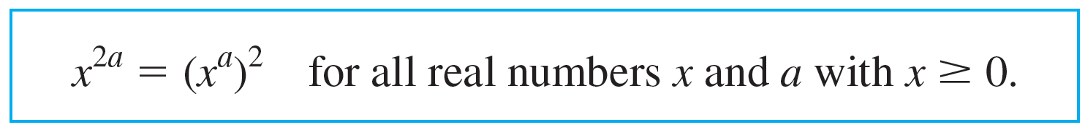
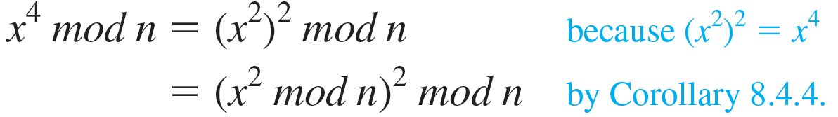
Modular Arithmetic
When modular arithmetic is performed with very large numbers, as is the case for RSA crytography, computations are facilitated by using two properties of exponents. The first is
8.4.1
Thus, for instance, if x is any positive real number, then

Slide 26
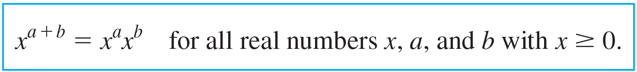

Modular Arithmetic
A second useful property of exponents is
8.4.2
For instance, because 7 = 4 + 2 + 1,
Thus, by Corollary 8.4.4,

Slide 27


Example 8.4.4 – Computing
mod n When k Is a Power of 2
Find

Slide 28

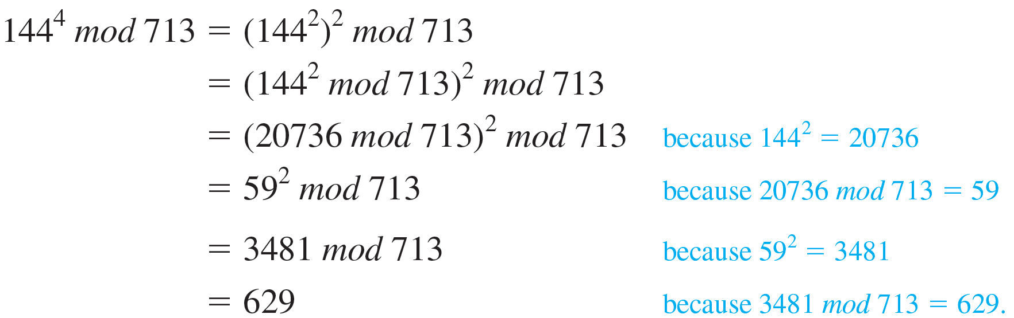
Example 8.4.4 – Solution
Use property (8.4.1) to write
Then

Slide 29

Example 8.4.5 – Computing
mod n When k Is Not a Power of 2
Find

Slide 30

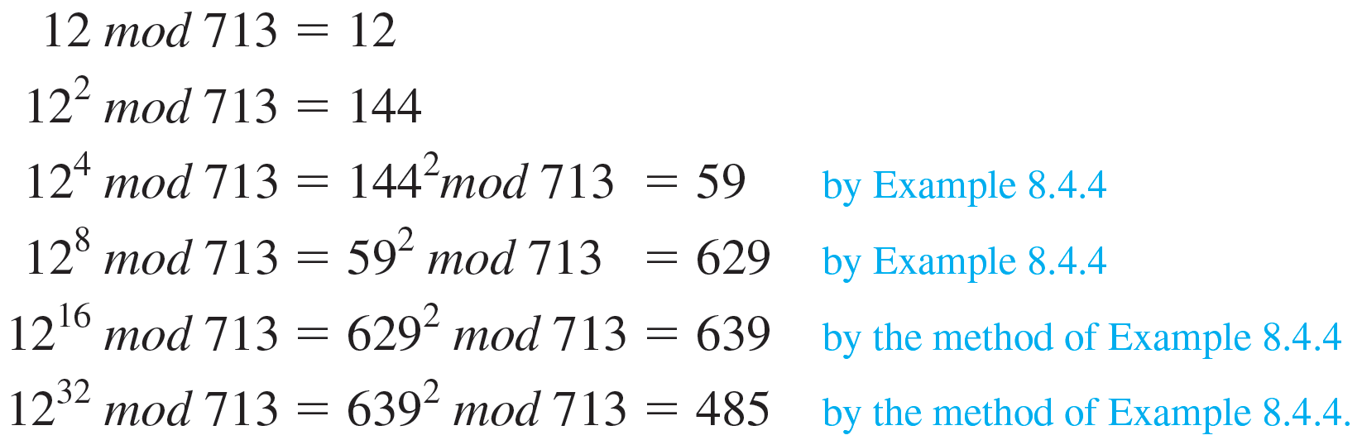
Example 8.4.5 – Solution
First write the exponent as a sum of powers of 2:
Next compute
for k = 0, 1, 2, 3, 4, and 5.

Slide 31
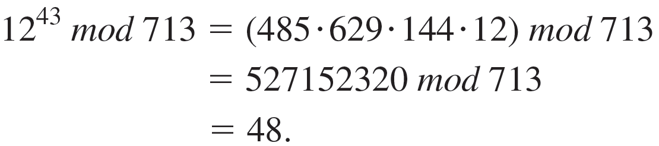
Example 8.4.5 – Solution
continued
By property (8.4.2),
Thus, by Corollary 8.4.4,
By substitution,

Slide 32
Extending the Euclidean Algorithm

Slide 33
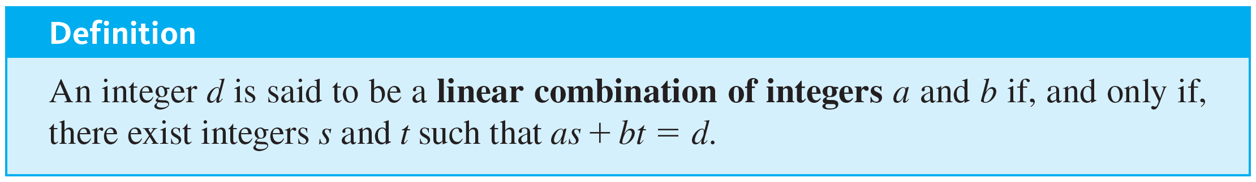
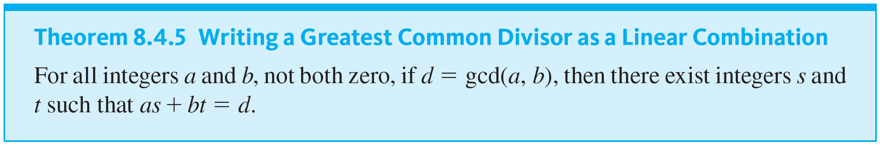
Extending the Euclidean Algorithm
An extended version of the Euclidean algorithm can be used to find a concrete expression for the greatest common divisor of integers a and b.

Slide 34
Example 8.4.6 – Expressing a Greatest Common Divisor as a Linear Combination
We know how to use the Euclidean algorithm to find that the greatest common divisor of 330 and 156 is 6. Use the results of these calculations to express gcd(330, 156) as a linear combination of 330 and 156.

Slide 35
Example 8.4.6 – Solution
The first four steps were obtained by successive applications of the quotient-remainder theorem. The fifth step shows how to find the coefficients of the linear combination by substituting back through the results of the previous steps.
Step 1: 330 = 156 · 2 + 18, which implies that
18 = 330 − 156 · 2.
Step 2: 156 = 18 · 8 + 12, which implies that
12 = 156 − 18 · 8.
Step 3: 18 = 12 · 1 + 6, which implies that 6 = 18 − 12 · 1.
Step 4: 12 = 6 · 2 + 0, which implies that gcd(330, 156) = 6.

Slide 36
Example 8.4.6 – Solution
continued
Step 5: By substituting back through steps 3 to 1:
6 = 18 − 12 · 1
from step 3
= 18 − (156 − 8 · 18) · 1
by substitution from step 2
= 9 · 18 + (−1) · 156
by algebra
= 9 · (330 − 156 · 2) + (−1) · 156
by substitution from step 1
= 9 · 330 + (−19) · 156
by algebra.

Slide 37
Example 8.4.6 – Solution
Thus gcd(330, 156) = 9 · 330 + (−19) · 156. (It is always a good idea to check the result of a calculation like this to be sure you did not make a mistake. In this case, you find that 9 · 330 + (−19) · 156 does indeed equal 6.)

Slide 38
Finding an Inverse Modulo n

Slide 39
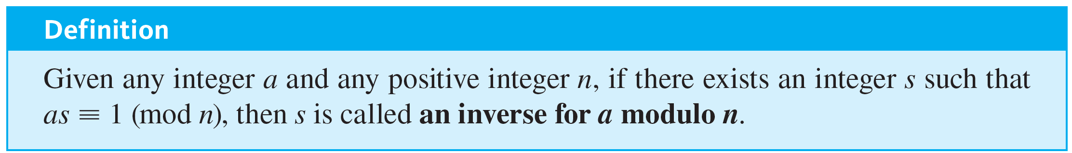
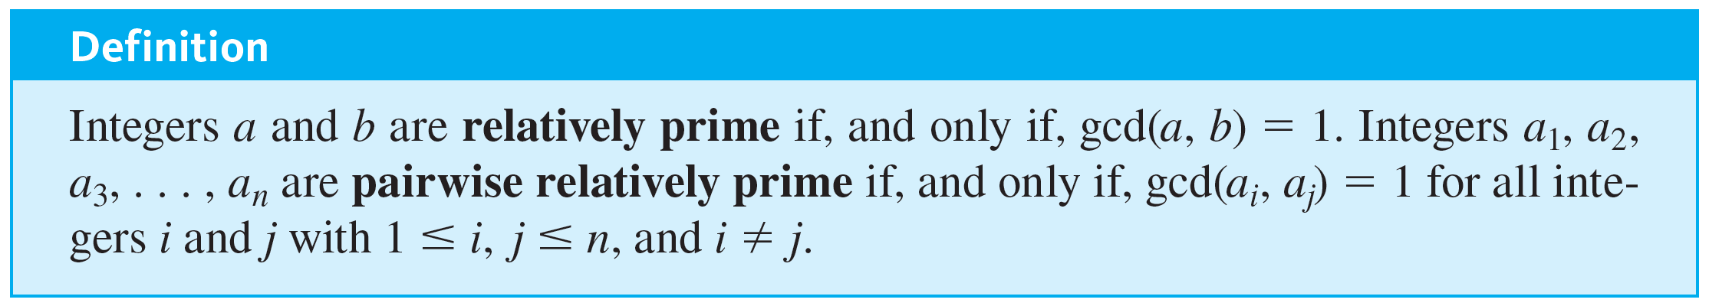
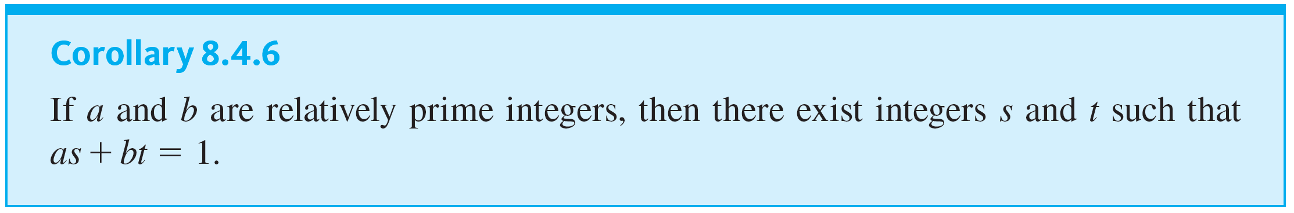
Finding an Inverse Modulo n

Slide 40
Example 8.4.7– Expressing 1 as a Linear Combination of Relatively Prime Integers
Show that 660 and 43 are relatively prime, and find a linear combination of 660 and 43 that equals 1.

Slide 41
Example 8.4.7 – Solution
Step 1: Divide 660 by 43 to obtain 660 = 43 · 15 + 15, which implies that 15 = 660 − 43 · 15.
Step 2: Divide 43 by 15 to obtain 43 = 15 · 2 + 13, which implies that 13 = 43 − 15 · 2.
Step 3: Divide 15 by 13 to obtain 15 = 13 · 1 + 2, which implies that 2 = 15 − 13.

Slide 42
Example 8.4.7 – Solution
continued
Step 4: Divide 13 by 2 to obtain 13 = 2 · 6 + 1, which implies that 1 = 13 − 2 · 6.
Step 5: Divide 2 by 1 to obtain 2 = 1 · 2 + 0, which implies that gcd(660, 43) = 1 and so 660 and 43 are relatively prime.

Slide 43
Example 8.4.7 – Solution
continued
Step 6: To express 1 as a linear combination of 660 and 43, substitute back through steps 4 to 1:
1 = 13 − 2 · 6
from step 4
= 13 − (15 − 13) · 6
by substitution from step 3
= 7 · 13 − 6 · 15
by algebra
= 7 · (43 − 15 · 2) − 6 · 15
by substitution from step 2

Slide 44
Example 8.4.7 – Solution
continued
= 7 · 43 − 20 · 15
by algebra.
= 7 · 43 − 20 · (660 − 43 · 15)
by substitution from step 1
= 307 · 43 − 20 · 660
by algebra.
Thus gcd(660, 43) = 1 = 307 · 43 − 20 · 660. (And a check by direct computation confirms that 307 · 43 − 20 · 660 does indeed equal 1.)

Slide 45
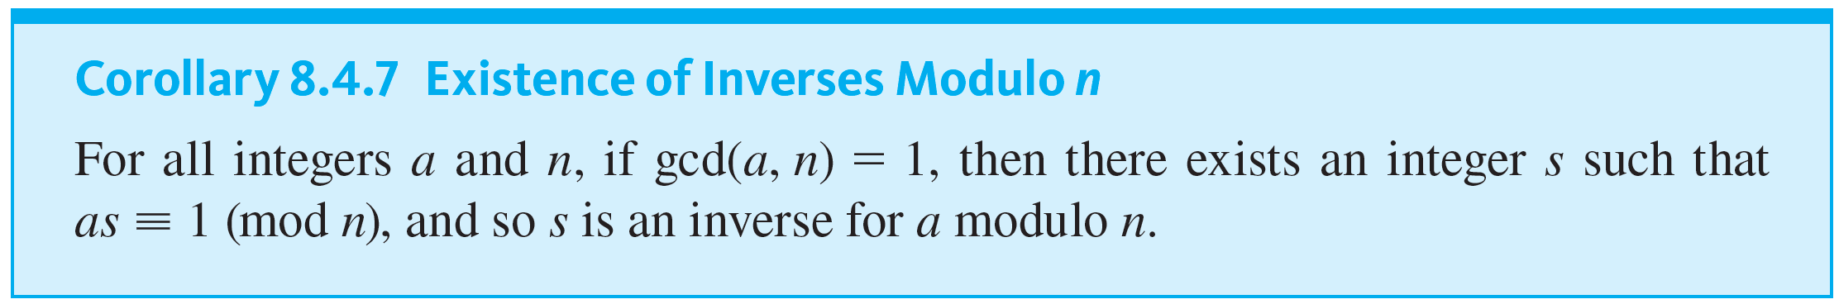
Finding an Inverse Modulo n

Slide 46
Example 8.4.8 – Finding an Inverse Modulo n
a. Find an inverse for 43 modulo 660. That is, find an integer s such that 43s ≡ 1 (mod 660).
b. Find a positive inverse for 3 modulo 40. That is, find a positive integer s such that 3s ≡ 1 (mod 40).

Slide 47
Example 8.4.8 – Solution
a. By Example 8.4.7,
307 · 43 − 20 · 660 = 1.
Adding 20 · 660 to both sides gives that
307 · 43 = 1 + 20 · 660.
Thus, by definition of congruence modulo 660,
307 · 43 ≡ 1 (mod 660),
so 307 is an inverse for 43 modulo 660.

Slide 48
Example 8.4.8 – Solution
continued
b. Use the technique of Example 8.4.7 to find a linear combination of 3 and 40 that equals 1.
Step 1: Divide 40 by 3 to obtain 40 = 3 · 13 + 1. This implies that 1 = 40 − 3 · 13.
Step 2: Divide 3 by 1 to obtain 3 = 3 · 1 + 0. This implies that gcd(3, 40) = 1.

Slide 49
Example 8.4.8 – Solution
continued
Step 3: Use the result of step 1 to write
3 · (−13) = 1 + (−1)40.
This result implies that −13 is an inverse for 3 modulo 40. In other words, 3 · (−13) ≡ 1 (mod 40).
To find a positive inverse, compute 40 − 13. The result is 27, and
27 ≡ −13 (mod 40)
because 27 − (−13) = 40.

Slide 50
Example 8.4.8 – Solution
continued
So, by Theorem 8.4.3(3),
3 · 27 ≡ 3 · (−13) ≡ 1 (mod 40),
and thus by the transitive property of congruence modulo n, 27 is a positive integer that is an inverse for 3 modulo 40.

Slide 51
RSA Cryptography

Slide 52
RSA Cryptography
In order to encrypt a message using the RSA cipher, a person needs to know the value of pq and of another integer e, both of which are made publicly available. But only a person who knows the individual values of p and q can decrypt an encrypted message.
We first give an example to show how the cipher works and then discuss some of the theory to explain why it works.

Slide 53
RSA Cryptography
Suppose Alice decides to set up an RSA cipher. She chooses two prime numbers—say, p = 5 and q = 11—and computes pq = 55.
She then chooses a positive integer e that is relatively prime to (p − 1)(q − 1). In this case, (p − 1)(q − 1) = 4 · 10 = 40, so she may take e = 3 because 3 is relatively prime to 40.

Slide 54
RSA Cryptography
The number pair (pq, e) is Alice’s public key, which she may distribute widely. Because the RSA cipher works only on numbers, Alice also informs people how she will interpret the numbers in the messages they send her.
Let us suppose that she encodes letters of the alphabet in a similar way as was done for the Caesar cipher:
A = 01, B = 02, C = 03, … , Z = 26.

Slide 55
RSA Cryptography
Let us also assume that the messages Alice receives consist of blocks, each of which, for simplicity, is taken to be a single, numerically encoded letter of the alphabet.
Someone who wants to send Alice a message breaks the message into blocks, each consisting of a single letter, and finds the numeric equivalent for each block.

Slide 56
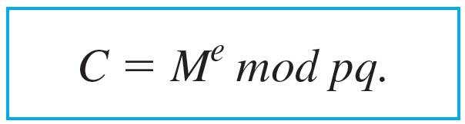
RSA Cryptography
The plaintext, M, in a block is converted into ciphertext, C, according to the following formula:
8.4.5
Note that because (pq, e) is the public key, anyone who has it and knows modular arithmetic can encrypt a message to send to Alice.

Slide 57
Example 8.4.9 – Encrypting a Message Using RSA Cryptography
Bob wants to send Alice the message HI. What is the ciphertext for his message?

Slide 58

Example 8.4.9 – Solution
Bob will send his message in two blocks, one for the H and another for the I. Because H is the eighth letter in the alphabet, it is encoded as 08, or 8.
The corresponding ciphertext is computed using formula 8.4.5 as follows:
= 512 mod 55
= 17.

Slide 59

Example 8.4.9 – Solution
continued
Because I is the ninth letter in the alphabet, it is encoded as 09, or 9. The corresponding ciphertext is
= 729 mod 55
= 14.
Accordingly, Bob sends Alice the message: 17 14.

Slide 60
RSA Cryptography
To decrypt the message, the decryption key must be computed. It is a number d that is a positive inverse to e modulo (p − 1)(q − 1).
The plaintext M is obtained from the ciphertext C by the formula
8.4.6

Slide 61

Example 8.4.10 – Decrypting a Message Using RSA Cryptography
Imagine that Alice has hired you to help her decrypt messages and has shared with you the values of p and q. Compute Alice’s private key (pq, d) and use the formula
to decrypt the following ciphertext for her: 17 14.

Slide 62
Example 8.4.10 – Solution
Because p = 5 and q = 11, (p − 1)(q − 1) = 40, the decryption key d is a positive inverse for 3 modulo 40. Knowing that you would need this number, we computed it in Example 8.4.8(b) and found it to be 27. Thus to decrypt the ciphertext 17, you need to compute
To do so, note that
27 = 16 + 8 + 2 + 1.

Slide 63

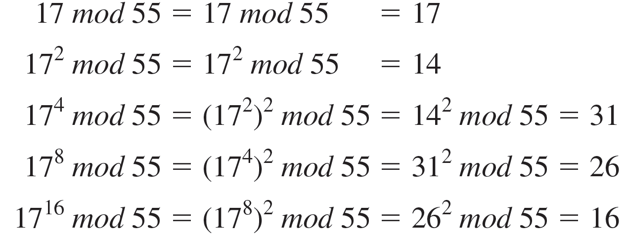
Example 8.4.10 – Solution
continued
Next, find the residues obtained when 17 is raised to successively higher powers of 2, up to

Slide 64
Example 8.4.10 – Solution
continued
Then use the fact that
to write
by Corollary 8.4.4
≡ (16 · 26 · 14 · 17) (mod 55)
≡ 99008 (mod 55)
≡ 8 (mod 55).

Slide 65

Example 8.4.10 – Solution
continued
and thus the plaintext of the first part of Bob’s message is 8, or 08. In the last step, you find the letter corresponding to 08, which is H.
In exercises 14 and 15 at the end of this section, you are asked to show that when you decrypt 14, the result is 9, which corresponds to the letter I, so you can tell Alice that Bob’s message is HI.
Hence

Slide 66
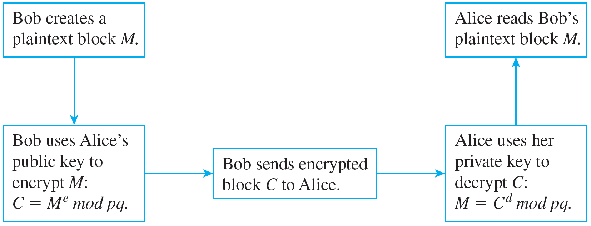
RSA Cryptography
Figure 8.4.1 illustrates the process of sending and receiving a message using RSA cryptography.
Using RSA cryptography
Figure 8.4.1

Slide 67
Euclid’s Lemma

Slide 68
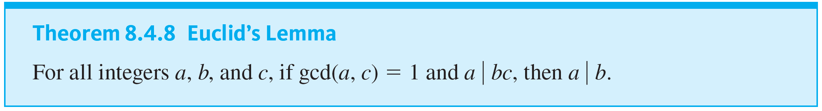
Euclid’s Lemma
Euclid’s lemma is the crucial fact behind the unique factorization theorem for the integers and is also of great importance in many other parts of number theory.

Slide 69
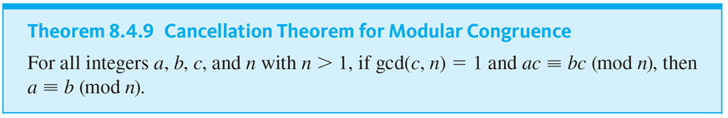
Euclid’s Lemma

Slide 70
Fermat’s Little Theorem

Slide 71
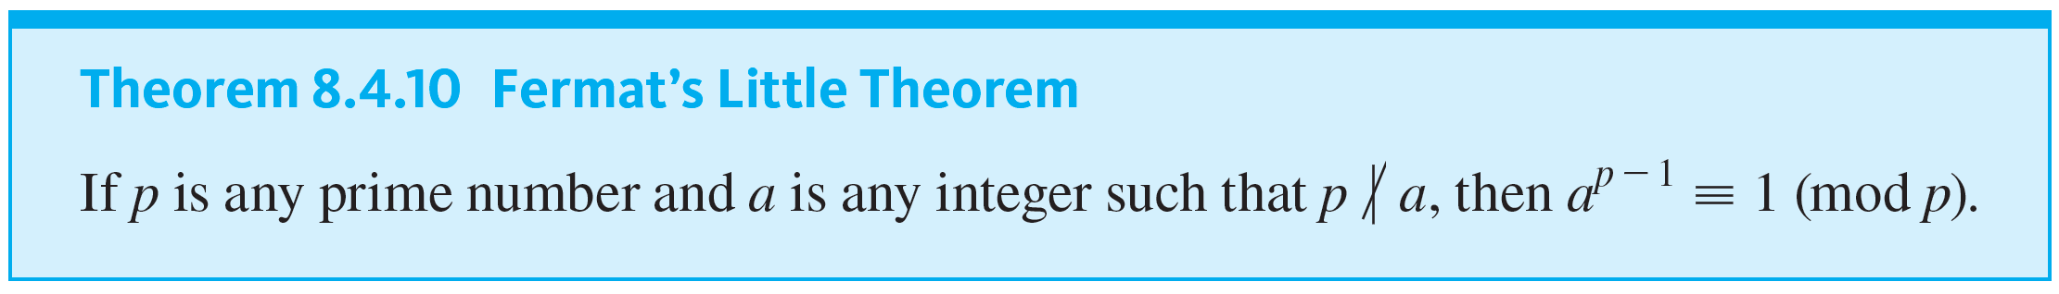
Fermat’s Little Theorem
Fermat’s little theorem was given that name to distinguish it from Fermat’s last theorem. It provides the theoretical underpinning for RSA cryptography.

Slide 72
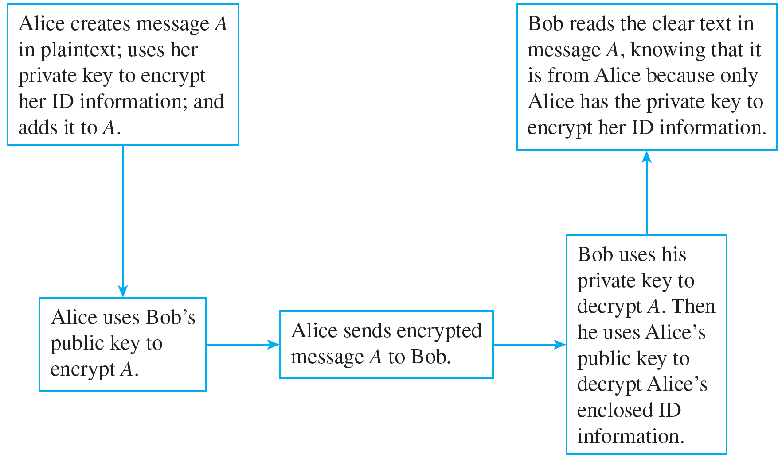
Fermat’s Little Theorem
The process of message authentication is illustrated in Figure 8.4.2.
Message authentication
Figure 8.4.2

